Slide 1
TEAM-C
Deep Raghuwanshi
Kundan
Devashish
V.S Goptherya
Tulsi Ram

Slide 2
Wireshark
Wireshark is a powerful, open-source network protocol analyzer that captures and Analyze network traffic.
Client to Server.

Slide 3
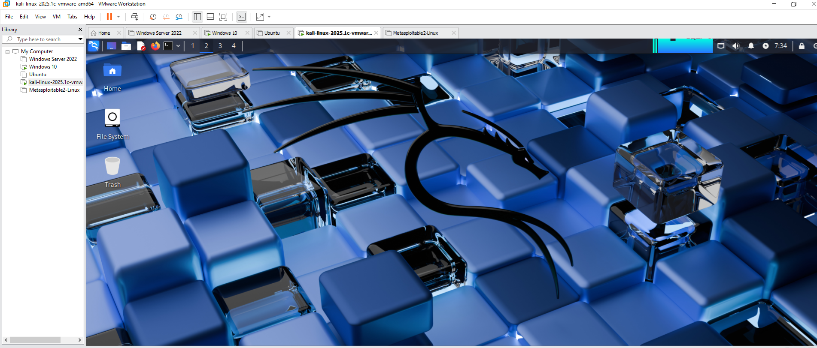
Steps
1. First go to kali linux

Slide 4
Protocols
-TELNET
- ICMP
- DNS
- HTTP
- HTTPS

Slide 5
TELNET
Telnet is a network protocol that allows you to connect to and communicate with remote computers over a TCP/IP network.
Port no 23.

Slide 6
ICMP
ICMP stands for Internet Control Message Protocol.
It's a network layer protocol used for error reporting and control messages in IP networks.
Example- Ping

Slide 7
DNS
DNS stands for Domain name server
It converts the domain name into Ip address and vice versa.
Port no. 53

Slide 8
HTTP
HTTP stands for Hyper text transfer protocol.
It is used for web communication.
Port no. 80

Slide 9
HTTPS
HTTPS Stands for hyper text transfer protocol.
It is used for web communication.
Port no. 443

